Slide 1





Unit 2 Attending Interview
Improving Interview Skills with the STAR Model

Slide 2







CONTENTS
1
Lead-in
2
The STAR Model
3
The Power of the STAR Model
4
Tips for Good STAR Responses
5
Interactive Practice with AI
6
Principle
7
Assignment

Slide 3




Lead-in
Unit 1 Preparing for Challenges

Slide 4




Lead-in
Unit 2 Episode 1
Know Your Company

Slide 5


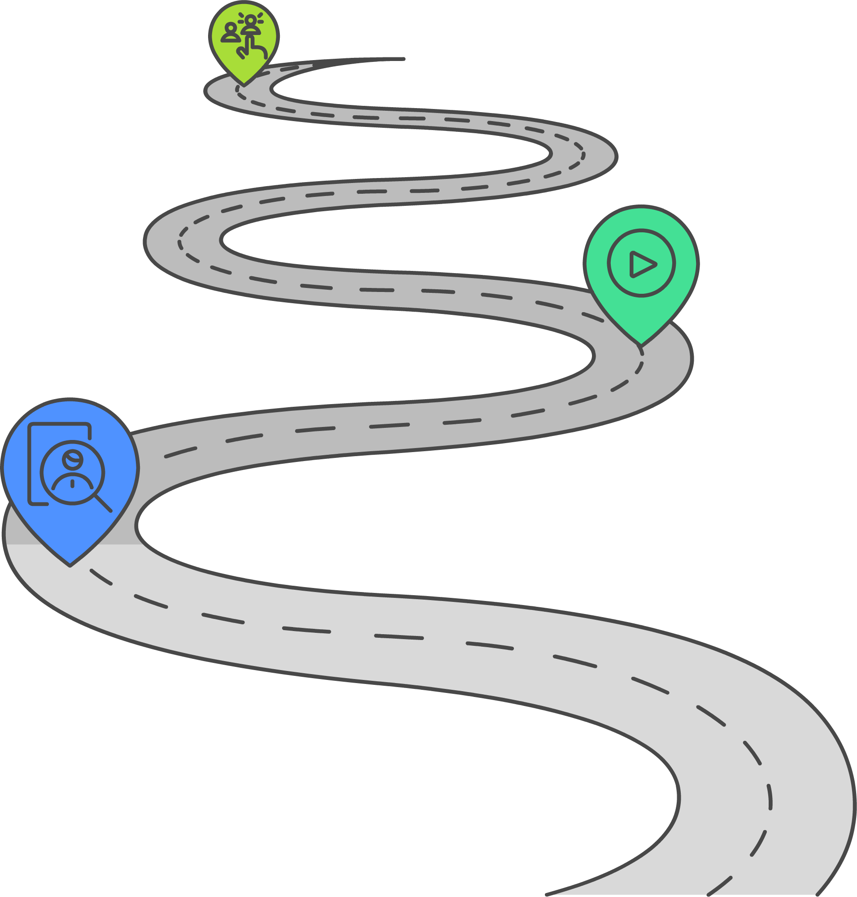
Lead-in
Unit 1 Preparing for Challenges
Unit 2 Episode 1
Know Your Company
Unit 2 Episode 2
Interview Rehearsal

Slide 6
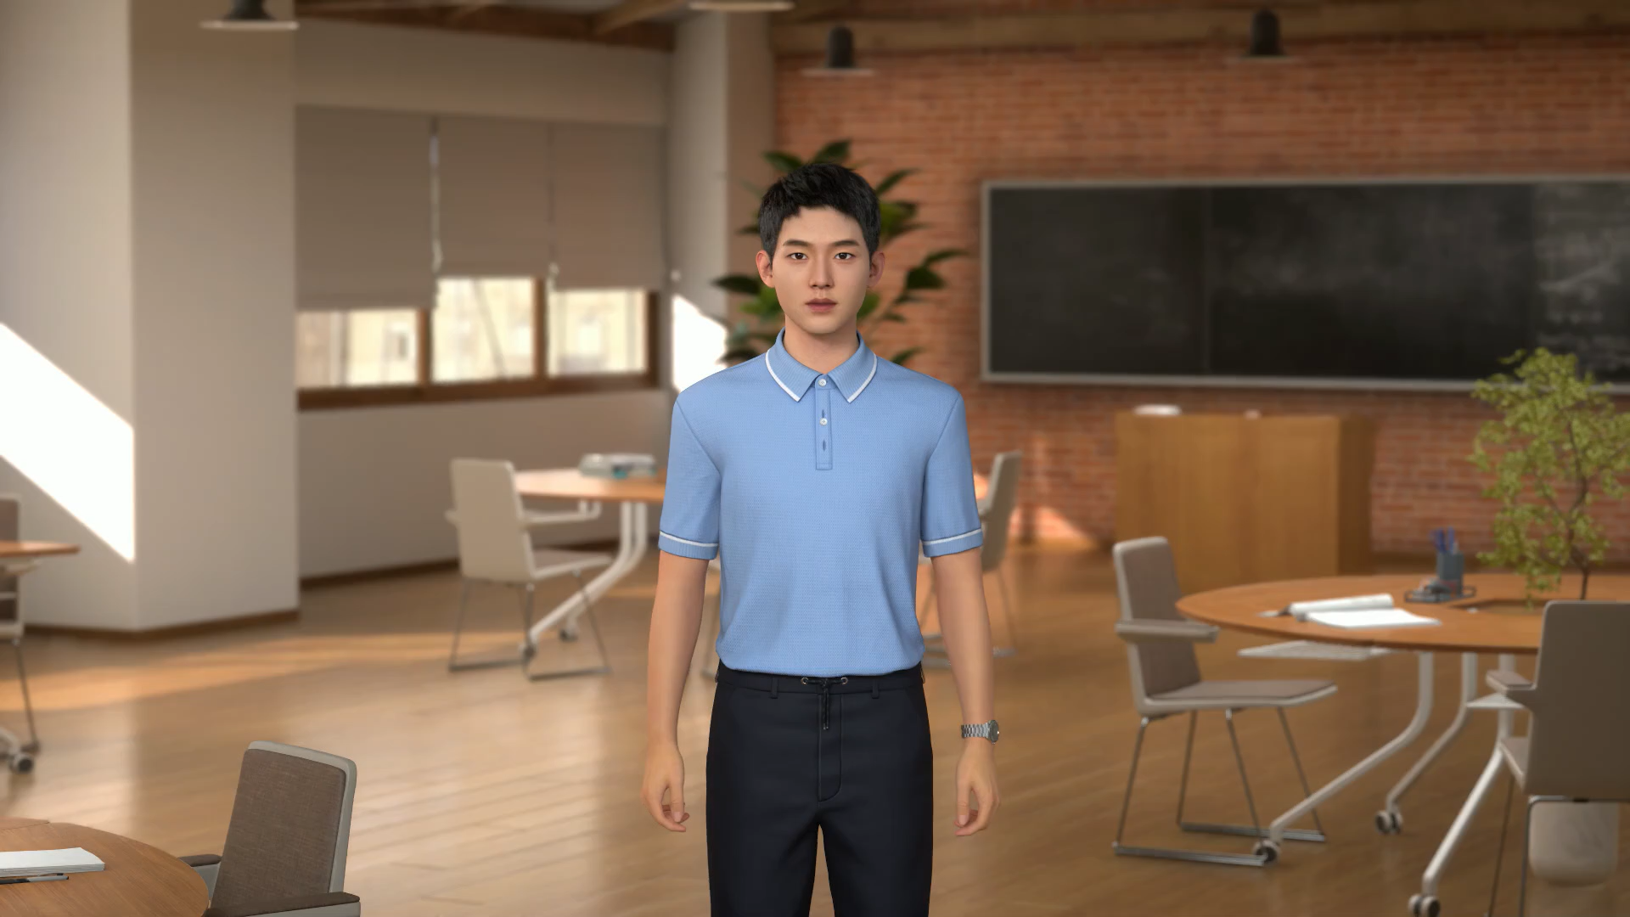

Slide 7



Interactive Practice with AI
Interview Master
Here’s how it works:
The AI (Interview Master) will ask you two questions, one of which is, “Why should we hire you?” After your answer, the AI will give you a score and detailed feedback on your structure, vocabulary, and fluency.
Scan the QR code to start practicing

Slide 8











The STAR Model
S
ituation
A
ction
T
ask
R
esult

Slide 9



The STAR Model
Tell the interviewer the SITUATION you were faced with.
SITUATION
S
T
A
R

Slide 10
The STAR Model
When I was learning ________________ class in university, I faced ________________________________.
SITUATION
S
T
TASK
ACTION
A
R
RESULT

Slide 11
The STAR Model
When I was learning Marketing Strategy class in university, I faced a tight deadline while designing a campaign for a mock product with my team.
SITUATION
S
T
TASK
TASK
Briefly explain the TASK you had to complete.
ACTION
A
R
RESULT

Slide 12
The STAR Model
When I was learning Marketing Strategy class in university, I faced a tight deadline while designing a campaign for a mock product with my team.
SITUATION
S
My task was to ________________________________, but the tricky part was ________________________________.
T
TASK
ACTION
A
R
RESULT

Slide 13
The STAR Model
When I was learning Marketing Strategy class in university, I faced a tight deadline while designing a campaign for a mock product with my team.
SITUATION
S
My task was to study survey data to find what influences customers, but the tricky part was handling incomplete or weird answers.
T
TASK
ACTION
ACTION
Give in-depth details about the ACTION you took to achieve the task.
A
R
RESULT

Slide 14
The STAR Model
When I was learning Marketing Strategy class in university, I faced a tight deadline while designing a campaign for a mock product with my team.
SITUATION
S
My task was to study survey data to find what influences customers, but the tricky part was handling incomplete or weird answers.
T
TASK
ACTION
I ________________________________, and ________________________________.
A
R
RESULT

Slide 15
The STAR Model
When I was learning Marketing Strategy class in university, I faced a tight deadline while designing a campaign for a mock product with my team.
SITUATION
S
My task was to study survey data to find what influences customers, but the tricky part was handling incomplete or weird answers.
T
TASK
I sorted and filtered the data, checked everything, and analyzed it from different angles to uncover hidden customer trends.
ACTION
A
R
RESULT
RESULT
Finish with the RESULT following your action.

Slide 16
The STAR Model
When I was learning Marketing Strategy class in university, I faced a tight deadline while designing a campaign for a mock product with my team.
SITUATION
S
My task was to study survey data to find what influences customers, but the tricky part was handling incomplete or weird answers.
T
TASK
What I did was sort and filter the data, checked everything, and then analyzed it from different angles to uncover hidden customer trends.
ACTION
A
In the end, I managed to _______________, which got ___________________________.
R
RESULT

Slide 17
The STAR Model
When I was learning Marketing Strategy class in university, I faced a tight deadline while designing a campaign for a mock product with my team.
SITUATION
S
My task was to study survey data to find what influences customers, but the tricky part was handling incomplete or weird answers.
T
TASK
I sorted and filtered the data, checked everything, and analyzed it from different angles to uncover hidden customer trends.
ACTION
A
In the end, I managed to complete a high-scoring project, which got our team nominated for the department's top award.
R
RESULT

Slide 18
The STAR Model
Tell the interviewer the SITUATION you were faced with.
S
SITUATION
T
TASK
Briefly explain the TASK you had to complete.
ACTION
Give in-depth details about the ACTION you took to achieve the task.
A
R
RESULT
Finish with the RESULT following your action.

Slide 19








The STAR Model

Slide 20
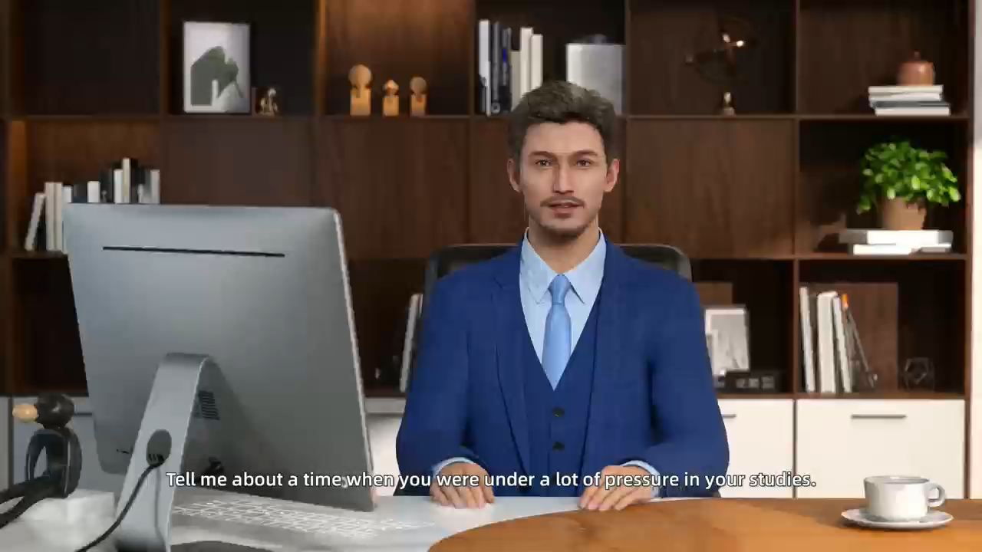

Slide 21











The Power of the STAR Model
STAR
STAR

Slide 22












The Power of the STAR Model
S
T
A
R

Slide 23





Tips for Good STAR Responses
Stick to the format: Situation, Task, Action, Result.
Give actual examples rather than saying what you
could or would have done.
Use "I" statements.
Use facts and figures when you talk about results.
Practice questions so you can answer confidently.

Slide 24

Interactive Practice with AI
Interview Master
Revisit Interview Master and see how much you've improved.
Scan the QR code to start practicing

Slide 25

Your Score:75/100
Weakness: In the Situation part, you could have been more specific about the nature ofthe client project and your exact role withinthe team.
Tip: Mention the industry of the client, what the project was aiming for initially, and your official title or responsibility in the team. This would provide a clearer context.

Slide 26

Interactive Practice with AI
Your Score: 80/100
Weakness: The response clearly defines the situation, task, actions, and results. However, it could be strengthened by sharing a lesson learned from this experience. For example, how did this project impact your approach to future efficiency - improvement initiatives?
Tip: Add a sentence about what you learned from implementing the new reporting system, like how you'll better assess the impact of future process - improvement projects or how you'll communicate similar changes more effectively in the future. This would make your answer more complete.
Your Score: 90/100
Weakness: You've clearly presented the situation, task, actions, and results. But the actions could be more detailed. For instance, what were the key elements of the customized solution?
Tip: Elaborate on the customized solution, such as if it involved new features, better service levels, or unique pricing. This would make your actions more tangible and your answer more impactful.
Your Score: 100/100
Weakness: There are no significant weaknesses in your response. You've effectively utilized the S.T.A.R. method, providing a clear situation, well - defined task, detailed actions, and highly quantifiable results.
Tip: To make your answer even more impactful in future interviews, you could briefly mention any adaptability or innovation aspects. For example, if there were unforeseen challenges during the implementation and how you overcame them.

Slide 27

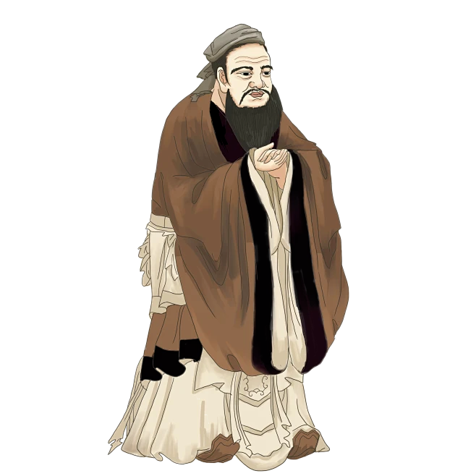

Principle

Slide 28
Principle
人而无信，不知其可也。
—— 《论语》
Without credibility,
you build no future.

Slide 29
Assignment
Mock Interview Practice
1. Review the STAR model.
2. Have a one-to-one mock interview to assess whether you can effectively use the STAR model.

Slide 30



Thanks！

